Slide 1
NASA Security Policies, Governance, and Breaches
Joseph Drouillard, Briah Graves, Anthony Jamieson
UIW – Network Security Management
Dr. Gonzalo D. Parra

Slide 2
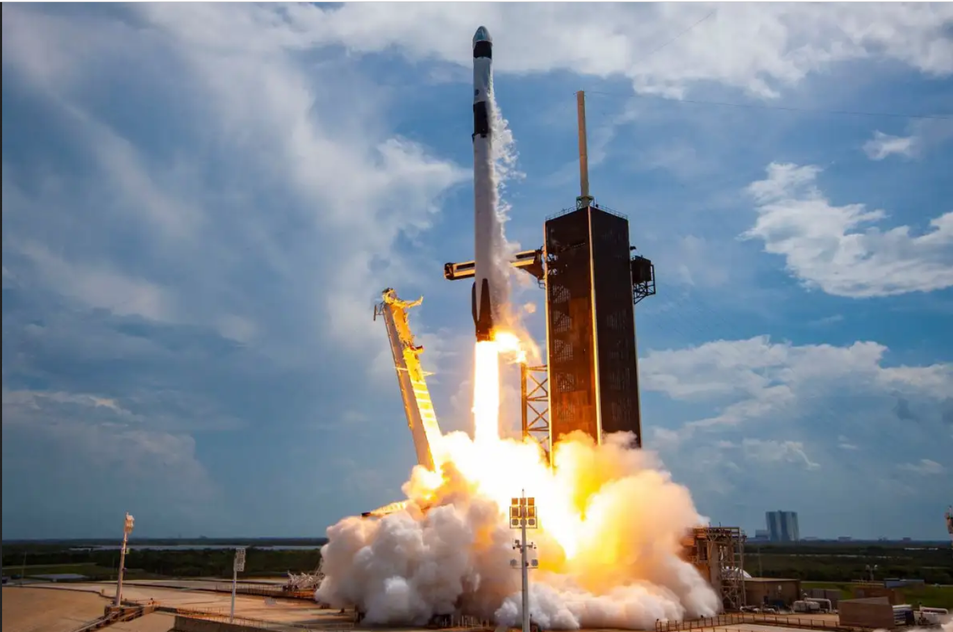
Vision and Mission
Vision - "Exploring the secrets of the universe for the benefit of all."
Mission - "NASA explores the unknown in air and space, innovates for the benefit of humanity, and inspires the world through discovery."

Slide 3

Core Values
Safety - The well-being of personnel and the general public is paramount.
Integrity - Ethics are held in high regard and cultivated through a culture of trust.
Teamwork – Each team member provides unique insight that allows NASA to obtain new solutions and opportunities. Communication and Collaboration are encouraged.
Excellence – Each team member is given adequate resources and is encouraged to reach their fullest potential in order to perfect NASA's mission.

Slide 4
NASA Roles and Governance

Slide 5
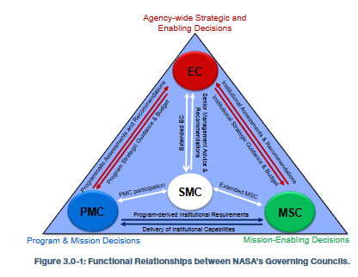
Governance Principles
Lean governance – NASA utilizes three senior leadership councils to oversee the organization – the Executive Council, Program Management Council, and the Mission Support Council.
Clear roles, responsibility, and decision making.
Strategic acquisition – A variety of acquisition methods are considered when tackling Agency needs.
Checks and balances – No one portion of NASA monopolizes resources or hijacks the mission focus, and communication is open.

Slide 6
Administrators at NASA
Chief Financial Officer-responsible for tracking cash flow and financial planning and analyzing the company’s financial strengths and weaknesses and proposing strategic directions
Chief Information Officer-oversees the people, processes and technologies within a company’s IT organization to ensure they deliver outcomes that support the goals of the business
General Counsel-a company’s main attorney and primary source of legal advice
STEM Engagement-has developed a series of STEM products and opportunities that provide a platform for students to contribute to NASA’s endeavors in exploration and discovery

Slide 7
Administrators at NASA (cont.)
Legislative and Intergovernmental Affairs-provides executive leadership, direction, and coordination of all communications and relationships, both legislative and nonlegislative, between NASA and the United States Congress as well as state and local governments
Communications-provides high-quality, reliable, cost-effective telecommunications systems and services for mission control, science data handling, collaboration, and program administration for NASA programs, projects, and facilities
International and Interagency Relations-ensuring that NASA’s international engagements are in alignment with Administration direction and U.S. laws and regulations

Slide 8
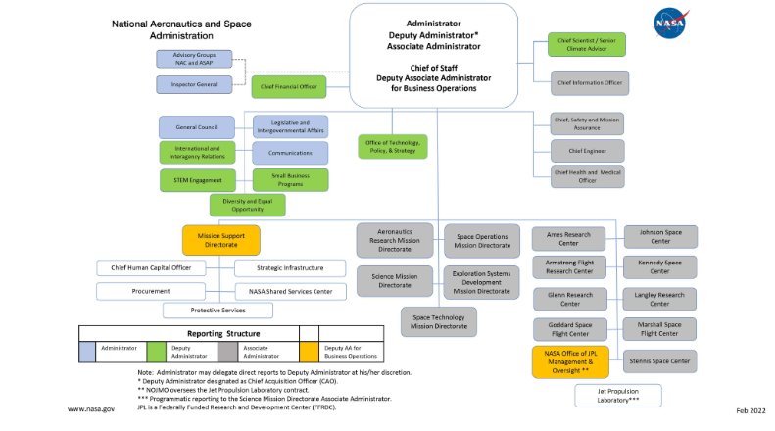

Slide 9
NASA Security Policies and Practices

Slide 10
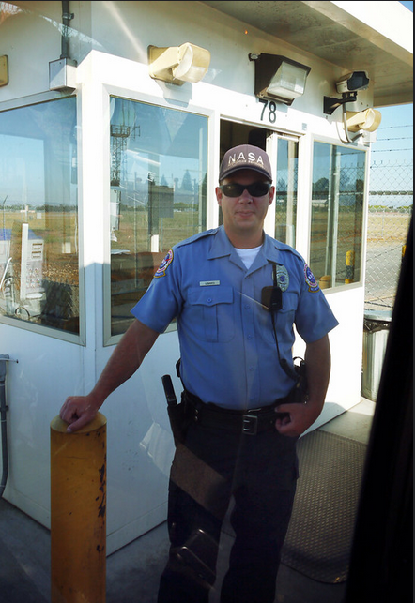
Physical Security
All NASA centers have access control points (ACPs) manned by security officers who validate visitors before entry. ACPs may have additional security measures if they protect a particularly sensitive area.
Visitors to NASA centers can be searched by authorized personnel for dangerous material at any time during their visit. This policy is displayed on signs to all legitimate entries.
NASA divides security areas into three types: controlled area, limited area, and exclusion area.

Slide 11

Information Security
NASA adheres to the guidelines given by NIST Special Publication 800 series, as well as the NIST Federal Information Processing standards.

Slide 12
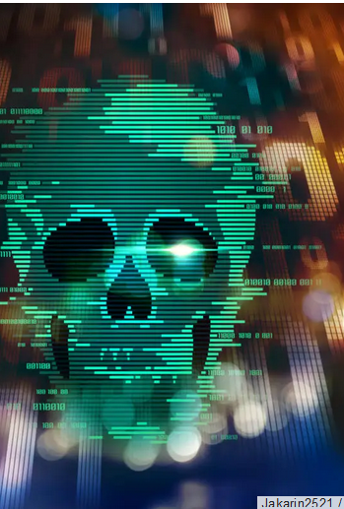
Cyber Security
All third-party software used within NASA must be vetted and approved by upper management before use.
If information system assets fail or information is compromised, an after-action report must be made.
In the Armstrong NASA center, the Office of the Chief Information Officer and IT Security personnel monitor, document, and manage network traffic. If malicious activity is suspected, the Center Director is notified. If the traffic is determined to be malicious by the Center information Security Officer, NPR 2800.2, NPR 2810.1, NPD 2810.1, and NPR 1841.1 are consulted.

Slide 13
Risk Management
NASA focuses primarily on five key domains of interest when considering risk:
Safety – The well-being of personnel and the general public, as well as the preservation of organization assets.
Mission success.
Physical security and cybersecurity.
Cost.
Schedule.

Slide 14
Risk Management (cont)
NASA's risk management process is composed of two activities – Risk Informed Decision Making and Continuous Risk Management.
RIDM focuses on how to meet performance requirements, and works by identifying decision alternatives, analyzing decision alternatives, and adopting a decision alternative.
CRM is meant to manage risk, and involves:
Identification of risk factors
Analysis of probability and impact
Plan mitigation and contingency plans, and risk tracking.
Tracking – Track variables indicative of risks.
Control – Discover if mitigation plans are sufficient.
Communicate and Document – Document the previous five steps.

Slide 15
Continuity of Operations
Legislation, such as EO 12656, HSPD-7, NSPD 51, OMC circular A-130, and the Computer Security Act of 1987 mandate continuity of operations for federal agencies, including NASA.
NASA defines five characteristics for a successful COOP state:
It can be put into practice on a moment's notice.
It can be maintained at a high readiness level.
It can take full effect within a maximum of 12 hours of initial activation.
It can maintain mandatory organizational operations for at least a month.
Takes all tools, assets, plans, and infrastructure into account.

Slide 16
Successful Attacks on NASA

Slide 17
2018 NASA Attack and Related Attacks – JPL Lab at Caltech in Pasadena, California
NASA Jet Propulsion Lab at Caltech in Pasadena, California is a hotspot of cyberattacks
In April 2018, an unauthorized Raspberry Pi gained access to JPL Servers
Hacker moved laterally through systems, accessing ones like the Deep Space Network radio telescopes
Attack made Johnson Space Center disconnect from JPL Gateway in fear of unauthorized access
Audit report for cyber incidents at JPL was released by NASA Office of Inspector General
Other attacks were listed
January 2009 – attacker stole 22GB of program data and transferred it to an IP address in China
2011 – Chinese-based IP addresses gained full access to 18 servers supporting key JPL missions
2014 – Cyber intruder uploaded malware to a server supporting JPL astronomical missions through web server
2016 - Website misconfiguration allowed anonymous user to escalate privileges and execute code on software architecture dev server
March 2017 – JPL server running source code for ground ops of scientific spacecraft was compromised by foreign hackers who executed code remotely without authentication

Slide 18
2018 NASA Attack and Related Attacks – JPL Lab at Caltech in Pasadena, California
Audit report confirms several faults in JPL security, such as:
Inadequate and outdated system IT inventories
Improper network segmentation
Untimely security log ticket resolution
Broken log management infrastructure
Inadequate SysAdmin training
Additionally, NASA OIG noted a lack of effective incident response procedures for JPL
Recommend 24/7 Security Operations Center staffing
IRP missing performance measures
Lacking metrics for measuring incident response capability and effectiveness
No annual review
NASA also noted how it was unable to monitor assets on the JPL Network
NASA OIG concludes with a ten-point plan of recommendations to help further secure JPL

Slide 19
1999 NASA Attack
In 1999, a 15-year-old boy hacked into Department of Defense computers
Hacker named Jonathan James accessed computers belonging to Defense Threat Reduction Agency
Used collected credentials and privilege escalation attacks to reach other government systems
James eventually reaches NASA’s Marshall Space flight center
James discovered source code for critical modules of the International Space Station
NASA began an internal investigation as soon as they knew about the attack
Investigation took three weeks and cost NASA around $40,000
Since James was a minor, he could not be charged for his attack

Slide 20
2006 NASA Attack
In 2006, over 150 government computers were broken into from Romania
26-year-old Romanian man Victor Faur, leader of hacking group “WhiteHat Team” was arrested and charged
Faur had hacked into NASA’s Goddard Space Center and Jet Propulsion Lab
Faur insisted he wanted to prove that many computers are vulnerable and that he did not modify or delete any files
NASA could not rely on integrity of data, including from spacecraft in Earth orbit and deep space, on hacked computers
NASA had to rebuild breached systems and manually gather data from spacecrafts, costing around $1.4 million dollars
Faur was charged with conspiracy and nine counts of computer intrusion, giving him up to 54 years of prison

Slide 21
NASA OIG Cybersecurity Readiness Report
In the 2021 Cybersecurity Readiness Report, NASA reflects on readiness to defend against different cyber threats
OIG states that in the past four years that NASA had experienced more than 6,000 cyber attacks
Includes phishing and introduction of malware into systems
In 2020 alone, OIG reports NASA identified 1,785 cyber incidents
Because NASA carries a lot of important scientific and classified data, they are a high-profile target for cyberattacks
This trend shows that attacks on NASA are on the rise as time goes on and further security improvements are going to be consistently needed

Slide 22
Thank you for listening!
Any questions?

Slide 23
Image References
NASA. (n.d.). Nasa Organizational Chart (Feb. 25, 2022). NASA. Retrieved November 30, 2022, from https://www.nasa.gov/sites/default/files/atoms/files/nasa_organization_chart_feb-25-2022.pdf
NewScientist. (2022). A SpaceX Falcon 9 rocket launch at Cape Canaveral, Florida. NewScientist. Retrieved November 28, 2022, from https://www.newscientist.com/article/2324367-emissions-from-rocket-launches-could-affect-earths-weather-systems/.
Gallup. (n.d.). Team members collaborating on project. Gallup. Retrieved November 28, 2022, from https://www.gallup.com/cliftonstrengths/en/278225/how-to-improve-teamwork.aspx.
Howell, C. (2020). Nasa guard shack. flickr. flickr. Retrieved November 28, 2022, from https://www.flickr.com/photos/seat850/5028654351.

Slide 24
Image References (cont)
Foundry. (2019). Green Binary Skull. CSO. Retrieved November 28, 2022, from https://www.csoonline.com/article/3295877/what-is-malware-viruses-worms-trojans-and-beyond.html.
Iowa State University. (2018). Nist Logo. csafe. Retrieved November 28, 2022, from https://forensicstats.org/download/nist-logo-2/.
NASA. (2014). Figure 3.0-1: Functional Relationships between Nasa’s Governing Councils. NASA. Retrieved November 28, 2022, from https://nodis3.gsfc.nasa.gov/NPR_attachments/N_PD_1000_000B_.pdf .

